Slide 1
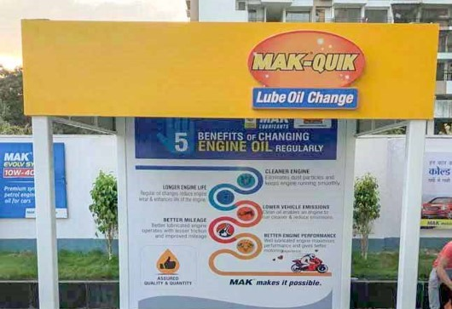
QOC BRANDING

Slide 2
Branding of QOC Kiosks

Slide 3


Branding Elements of QOC Kiosks
Approved Backdrop (English)
QOC Machine Branding

Slide 4
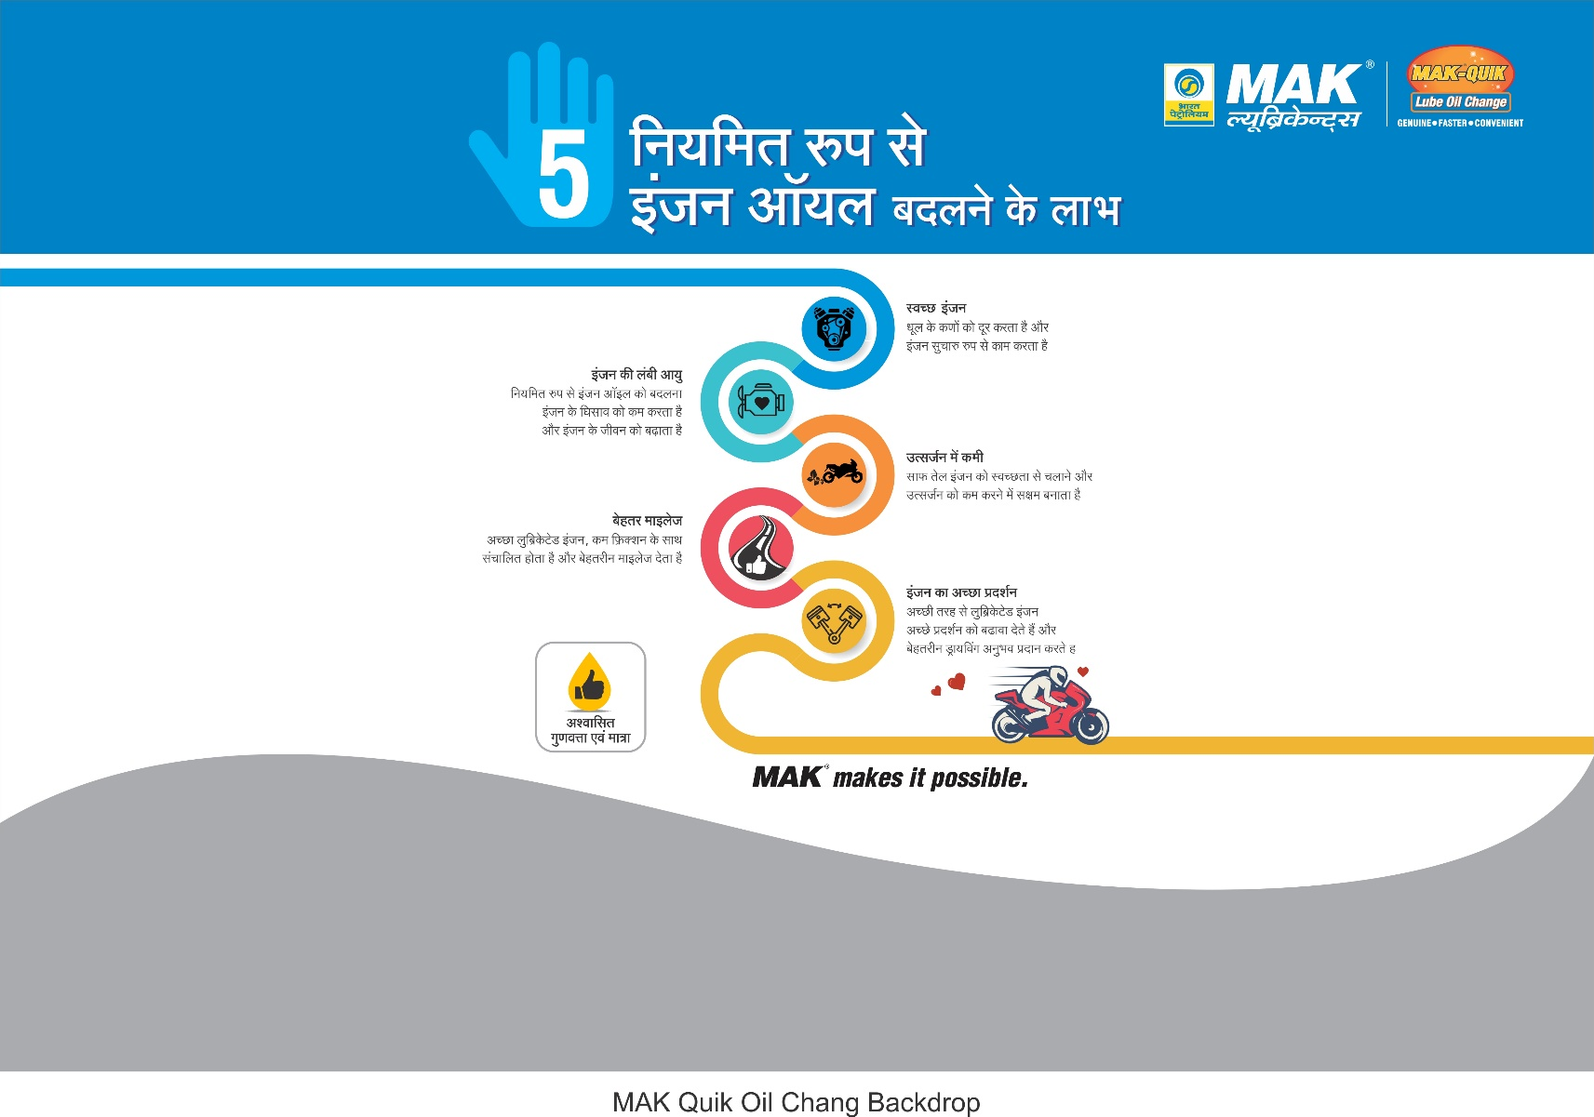
Branding Elements of QOC Kiosks
Approved Backdrop (Hindi)

